Slide 1

Welcome to the world of
KKT PPT education
Notes:
This is a welcome slide. Teacher may change it.

Slide 2


Identity
Komal Kanta Ray Talukder
Senior Teacher,L.P.High School & College
Chhatak.Sunamgonj.
Cell:01714529249
Class IX_X
English 2nd paper
Grammar
Notes:
Identity of the teacher and class.

Slide 3
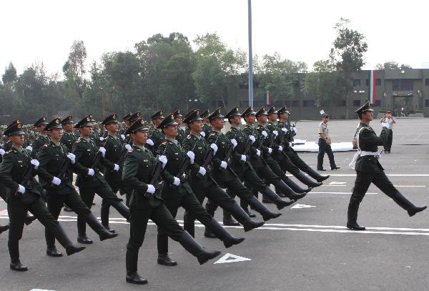
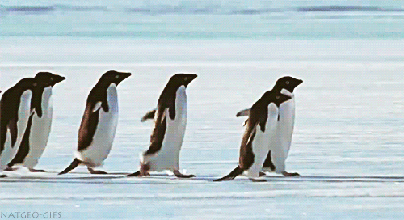

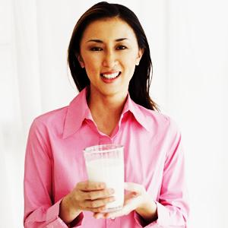

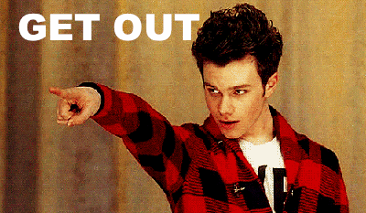
March on
Do it at once
Let’s go
Take it please
Order, request, proposal, advice and command.
Notes:
Definition of imperative sentence.

Slide 4

What kind of sentence have
you meant by the pictures?
Imperative sentence
Notes:
Suspension to lead the lesson.

Slide 5

Our today’s topic is-
Imperative Sentence
Notes:
Lesson declaration.

Slide 6

Learning outcomes
After studied this lesson ,we will be able to—
identify the definition of imperative sentences
identify the structures of imperative sentences
rearrange the jumbled words to make imperative sentences.
make imperative sentences with clue
Notes:
All the above points will be focused in this lesson.

Slide 7
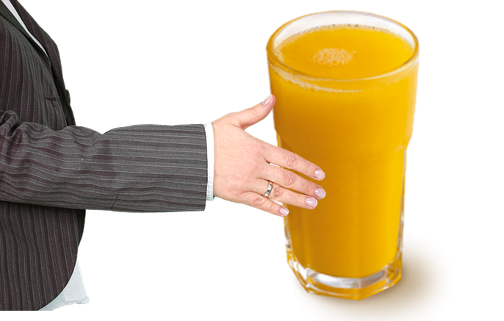
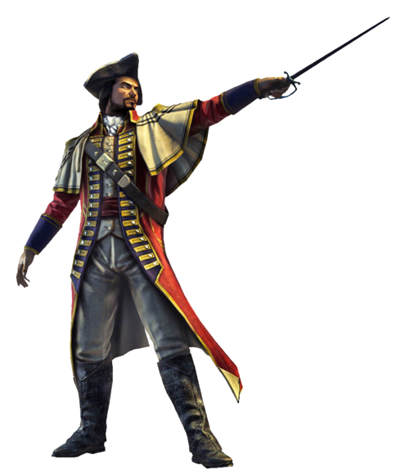
What is an imperative sentence?
Please take the glass of juice.
(Request)
Attack them.
(Command)
Never tell a lie.
(Advice)
The sentence we mean order, request, command
and advice is an imperative sentence .
Notes:
Definition of imperative sentence shown through example.

Slide 8

Follow
Say your morning prayer.
Let us go out for a walk.
Imperative sentence is
divided into two categories
Imperative without ‘Let’
Always speak the truth.
Imperative with ‘Let’
Let me say something.
Notes:
Suspension to lead imperative sentence.

Slide 9
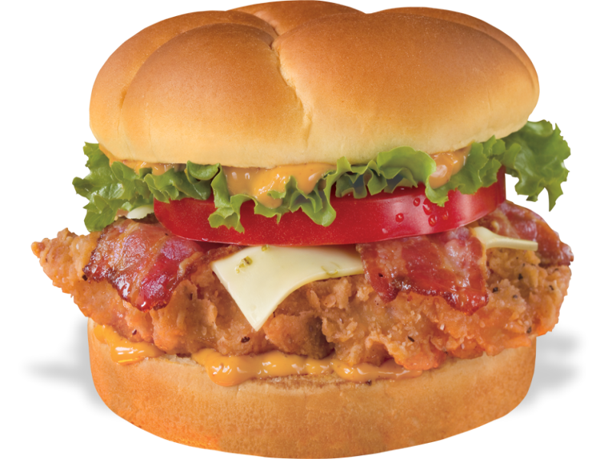
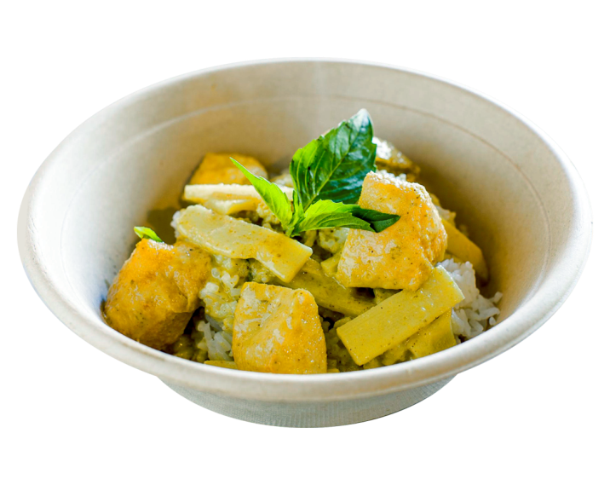
Formation of imperative sentence-1
If the sentence is related to only second person (you), it will be---
Action verb
+
+
object
Extension (if it is).
Leave
junk food.
Eat
vegetables.
Notes:
The structure is triggered. ‘No’ is used before noun and ‘not’ is used before another parts of speech.

Slide 10
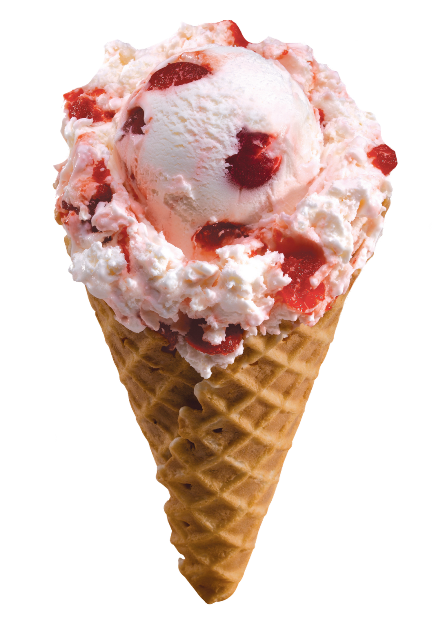

Imperative sentence in negative form-1
If the sentence is formed with action/do verb, the structure will be ---
+
+
extension
Don’t
verb
eat
Don’t
an ice-cream.
Don’t
ruin
your future.
Notes:
The structure is triggered twice. Negative structure of assertive is shown here.

Slide 11
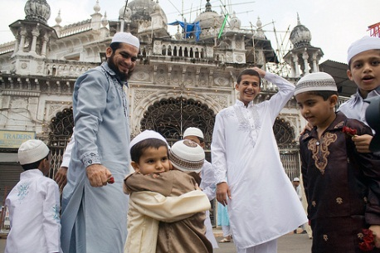
Formation of imperative sentence-2
If the sentence is related to 1st/3rd person (me/us/him/them/a name, it will be---
Let
+
object
+
verb
+
extension (if it is).
Let
me
say
my prayer.
Let
us
go
to mosque.
Notes:
The structure is triggered twice. ‘No’ is used before noun and ‘not’ is used before another parts of speech.

Slide 12
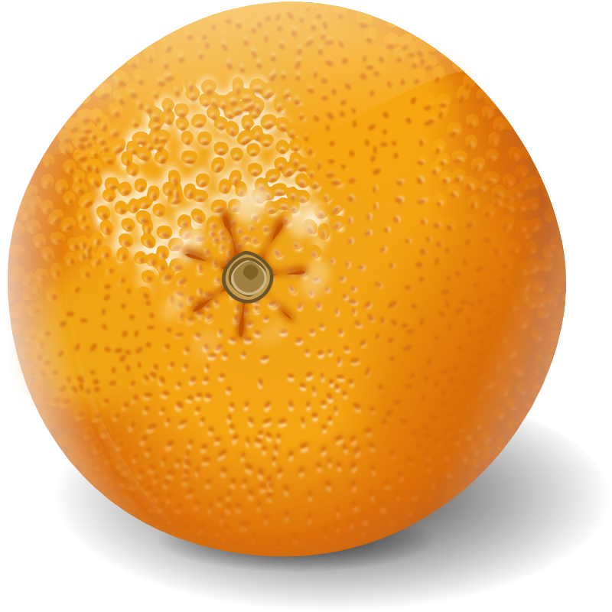
Class Activities
Re arrange the jumbled words to
make 5 imperative sentence.
eat, everyday, malta , a,.
lemonade, not, do, drink,
my, follow, advice, carefully.
water, not, drink, do,drink, cola,
us, let, buy, oranges, some,
Notes:
Evaluation on assertive sentence. LO No. 3 will be achieved.

Slide 13
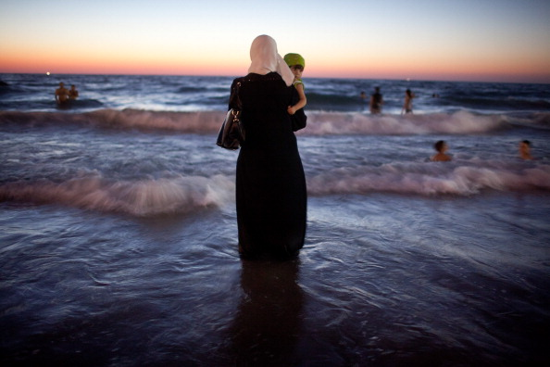
Make five imperative sentences on the picture.
Notes:
Learning outcomes point No. 4 will be focused by this slide.

Slide 14
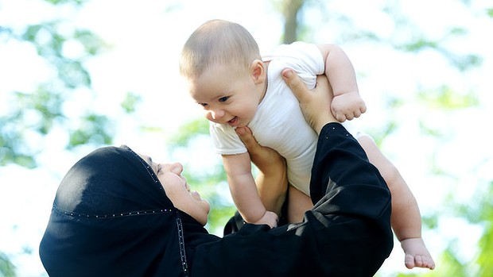
May Allah bless you
Notes:
Ending slide.

